Slide 1
Weather station
IoT Weather Station
By
Andreas Ellebæk Sivertsen
Henrik Kjær Jeppesen

Slide 2
Overview
Weather station functions
Sensor
Rain guage

Slide 3
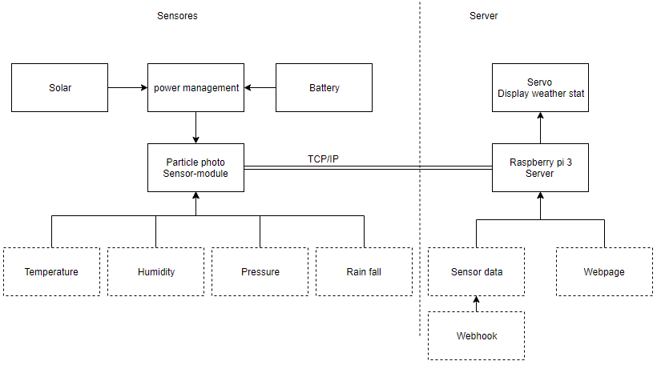
Weather station functions
Temperature
Humidity
Pressure
Rain fall amount
Wep server with status
Servo displaying weather

Slide 4
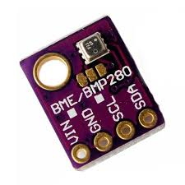
Sensor
BME280
Function it have:
Interface: I2C
Temperature -30 to + 50 C(+/-0,5c)
Humidity +/-5%
Pressure +/-2 hPa

Slide 5
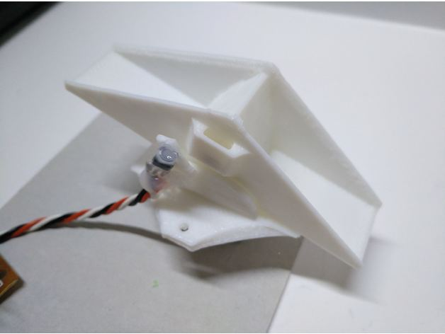
Rain guage
Tip at certain amount of water.
Calculating the mm of rain.
Maybe not the final model used from thingivers.com
Notes:
https://www.thingiverse.com/thing:2621112
https://www.thingiverse.com/thing:3747090

